Slide 1
CoviCOM2.0
Idea :-
To build an all-in-one Covid-19 website for India, which will be a one-stop solution to everyone’s needs during this pandemic
Theme:- Healthcare

Slide 2

Key points of the project
Provides updated COVID-19 cases count – active, confirmed and recovered in all districts of India
Allows user to check the presence of Vaccination centres in his/her locality
Provides details of availability of vaccine doses in various Vac-centres throughout India

Slide 3
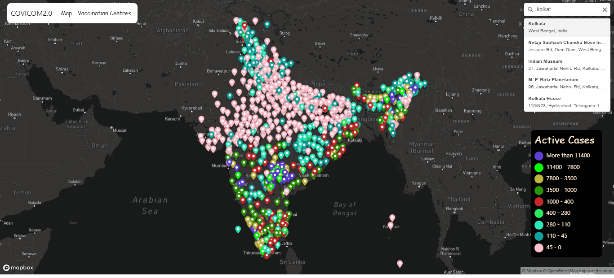
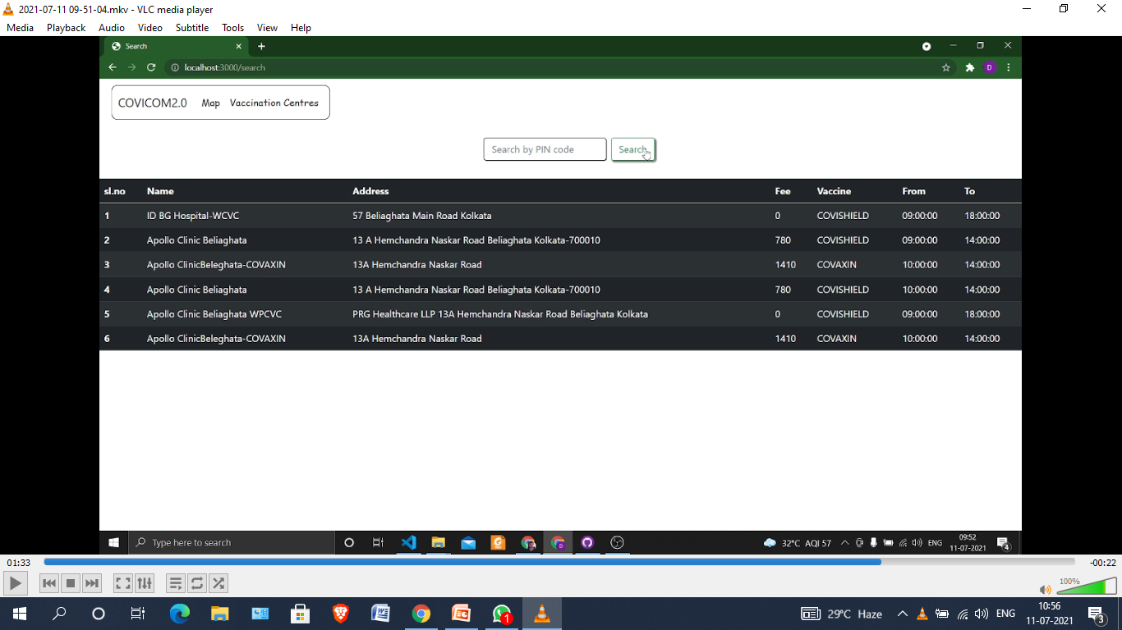
Screenshots

Slide 4

Data Collection Sources
https://www.latlong.net/ - for district coordinates
https://api.covid19india.org/v2/state_district_wise.json - district wise covid info
https://raw.githubusercontent.com/dipayandas2002/udemy/main/exp/longlat.jso - district coordinates
https://cdn-api.co-vin.in/api/v2/appointment/sessions/public/findByPin?pincode=pincode&date=date-month-year – pincode wise vaccination data

Slide 5
Skills and Toolkits used
Html5
CSS3
Javascript
Mapbox GL JS
Node.js
Body-parser
Express
Node-fetch
Get-JSON

Slide 6
Bugs and Scope of Improvement
Bugs
Sometimes the map stops loading completely, if there is network issues
Sometimes the Map pointers don’t show up due to data fetching issues
Scope
Improve page loading time
Detect current location of the user automatically
Provide district-wise data of all COVID-19 healthcare services (hospitals and beds available)
Include covid-19 updates from the user’s state government

